Slide 1
virtual event platform
Event Platform for In-Person, Virtual, and Hybrid Events

Slide 2
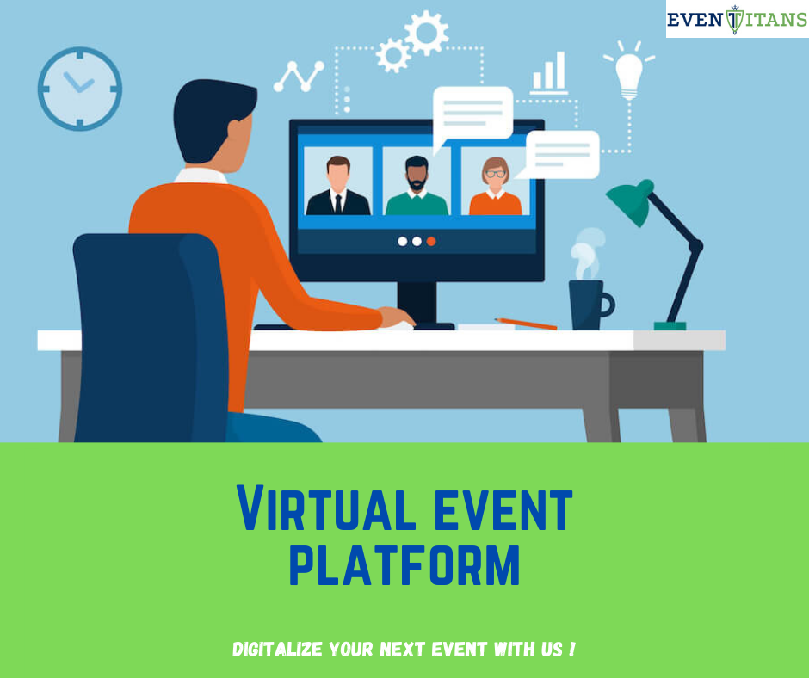

Slide 3
Eventtitans is the world’s most loved event management software Our holistic Events Cloud empowers marketers and planners to manage, grow and maximize their events

Slide 4
Build a virtual event platform that keeps the look and feel of an in-person event with EventTitans! We offer a virtual lobby, networking room, exhibitor booths, and more with our innovative solution.

Slide 5

Thank You

